Slide 1
Building a Sigfox application and creating a replay attack
Aarjav Kothari, Pragya Sharma, Michael Sherman

Slide 2



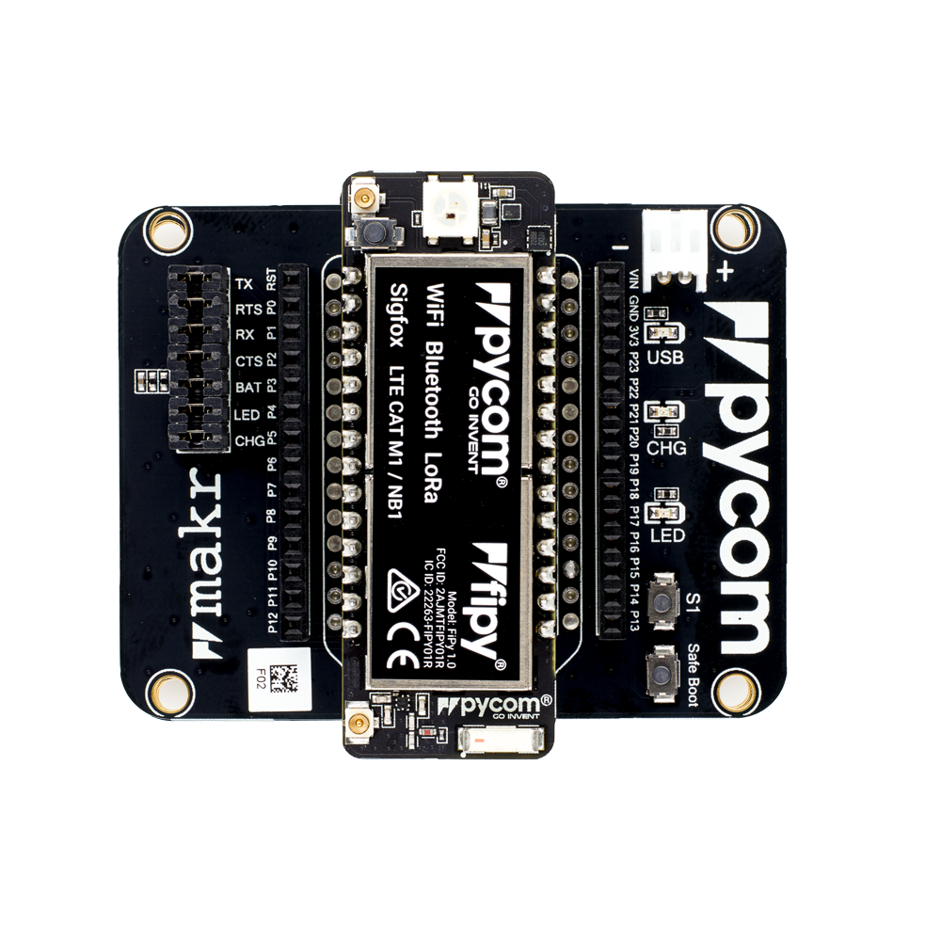
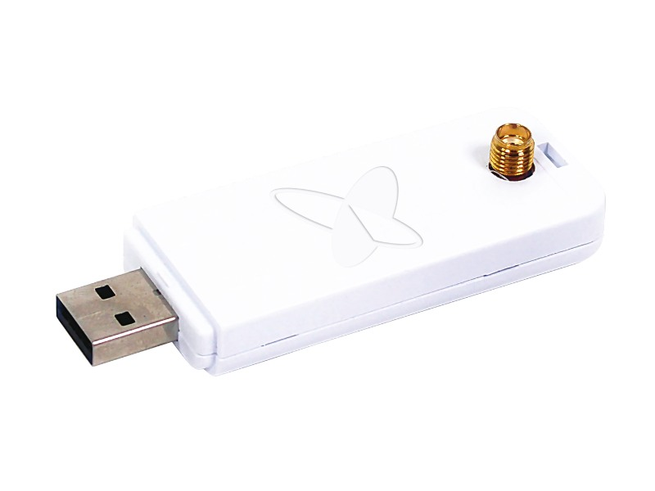
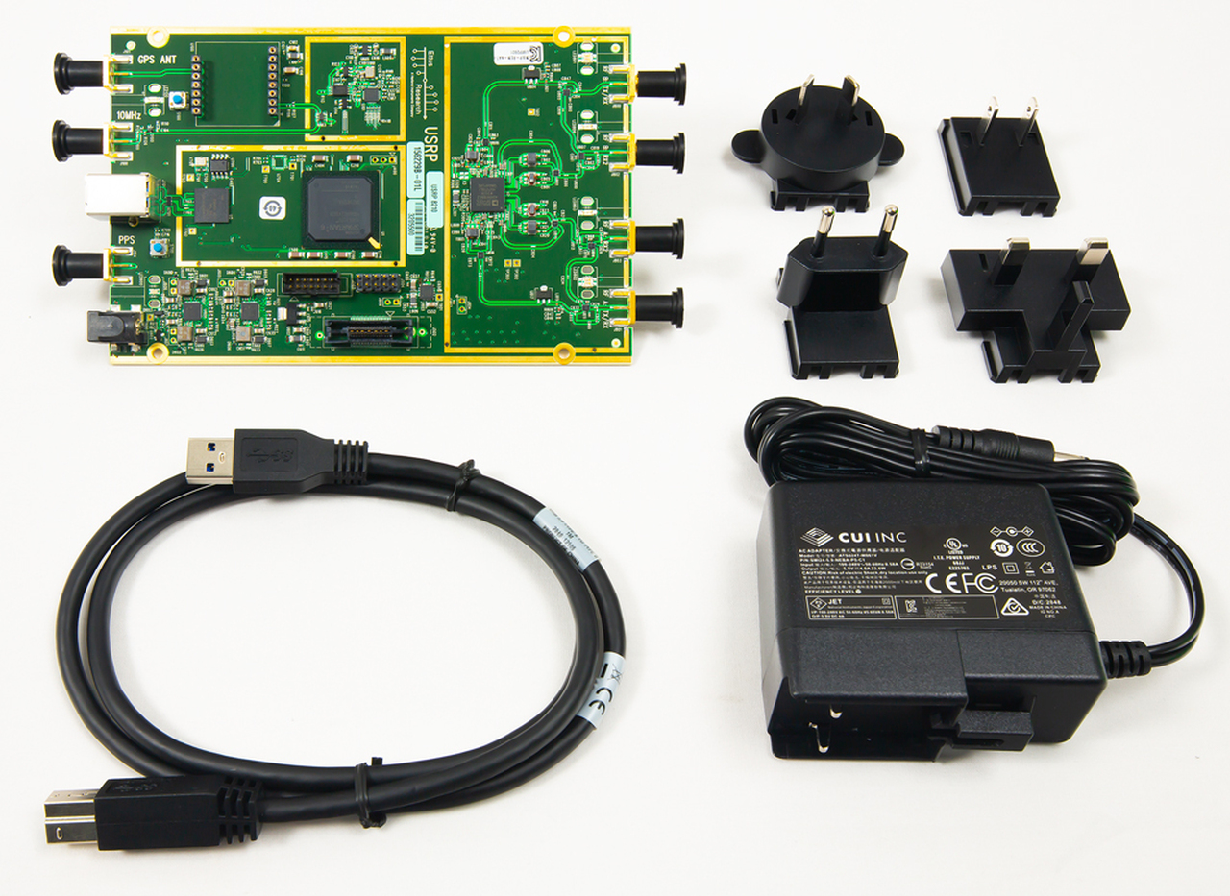
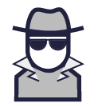
Motivation and Problem Space
Notes:
Explain sigfox, pycomm, BS, man-in-the-middle attack
In this project, we set up two devices to communicate with each other. We set up a plug-and-play Pycom FiPy to act as a “Sigfox” device to communicate with the Sigfox base station (SNE - Sigfox Network Emulator, which emulates a base station). Once having connected the FiPy to a computer over USB and having downloaded the Pymakr extension for our preferred code editor, we can run code on the FiPy that attempts to communicate with local Sigfox applications over the RC2 Radio Configuration (RC2 is for the US and it operates in the 900MHz frequency band). One can perform several different actions of communication, namely the uplink and downlink. The uplink involves sending data to the Sigfox base station while the downlink involves receiving information from the Sigfox base station.

Slide 3
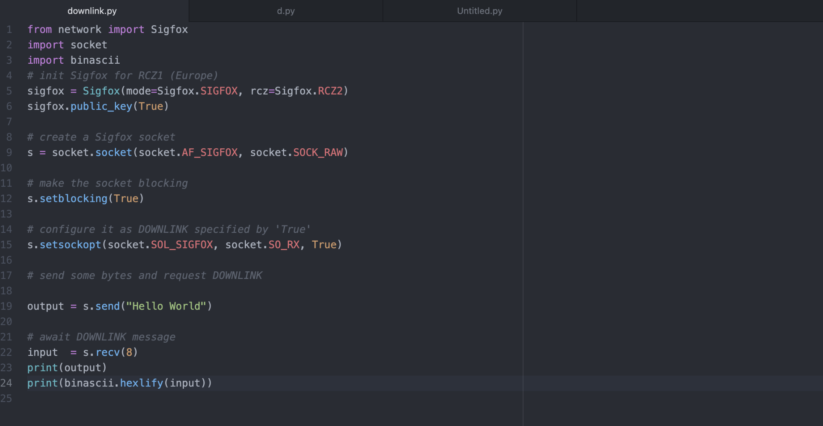
Part 1: Sigfox communication
Sigfox Setup
SDR Dongle
Sigfox Network Emulator (SNE)
Registering Devices
Finding Pycom ID
Authentication
Advanced Encryption Standard 128 (AES)
Enable/Disable public key authentication
Uplink/Downlink
Notes:
Responsible: Mike
Explain/show screenshots of Pycomm script and sigfox BS uplink
Radio Configuration 2 (RC2) is the 900 Mhz frequency band that Sigfox designates for the US.
The Sigfox application is a combination of the SDR Dongle hardware and the Sigfox Network Emulator (SNE) software solution. The SDR
Dongle is a USB stick that can connect directly to your personal
device and comes with an antenna to receive incoming messages.
The SNE emulates a Sigfox base station and is not connected to the
Sigfox backend (on the cloud). In order to communicate with the two, we first had to retrieve
the identity of the Pycomm FiPy and register it within the Sigfox SNE. Once
this connection is established and the SNE is running, we can ping/test the uplink of
our Sigfox base station by running the FiPy code.
One important thing to note is that Sigfox uses Advanced Encryption Standard
(AES) 128 public key encryption to perform authentication and data
integrity checks [4]. Each Sigfox device has the option to enable
or disable AES. Without authentication enabled, the SNE can still
receive messages via the uplink but cannot authenticate the sender and thus cannot
send downlink messages in response. Additionally, you must manually enable the Pycom
device to use this public key in the python code. (the Pycomm device acts as our sigfox device)

Slide 4
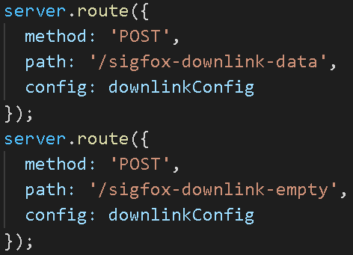
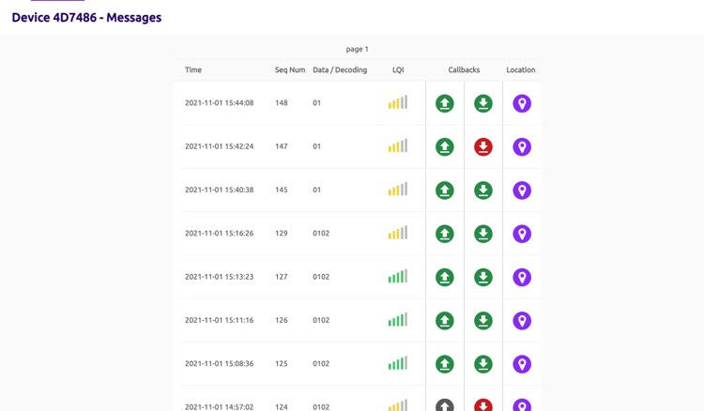
Challenge #1: Sigfox communication
Downlink
Small message payloads
Requires Authentication
Callback
Localhost
Sigfox Backend
Unstable indoors
Better performance outdoors
Notes:
Responsible: Mike
The Sigfox network itself is bidirectional and tries to achieve very low energy consumption in several ways. One of which is the fact that it is all about small message sizes.
Each uplink message can be a maximum of 12 bytes long and there is a limit of 140 uplink messages per day.
Each downlink message sent back to devices can only be 8 bytes long and there are limits to how many can be transmitted (4 per day).
Authentication is required to test the downlink. Without authentication disabled, the SNE can still receive messages via the uplink but cannot authenticate the sender and thus cannot send downlink messages in response. When sigfox SNE receives a downlink, it sends a uplink message with a flag telling the sigfox backend(?) that it is expecting a downlink message. 20-40 seconds later, the downlink message will be sent back from the base station to the device. To enable the downlink, you must specify a callback, which will send a request to the indicated url (a cloud backend or a localhost application) which will parse the data contained in the packet.
Hapi.js setting up basic routes locally and an 8-byte response.
Sigfox Backend - cloud application where you can configure your callbacks

Slide 5
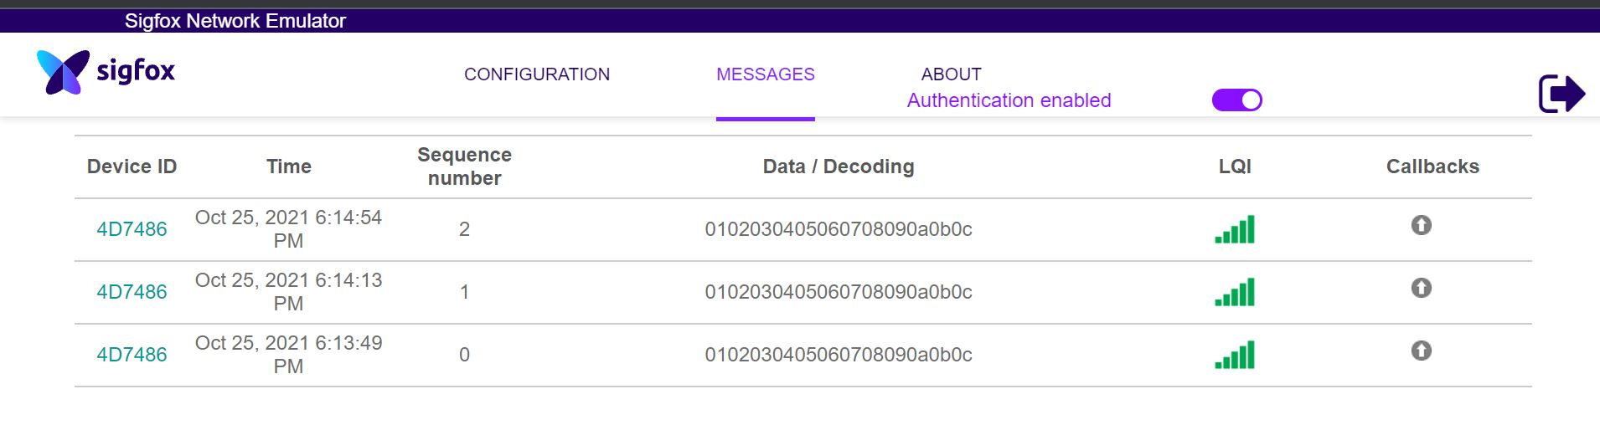
Part 2: Man-in-the-middle attack using USRP
Registered Device
Authentication Switch
No handshake mechanism!
Notes:
The intention behind this attack - sigfox does not use any handshake mechanism and relies solely on device ID and packet authentication (Which can even be turned off)

Slide 6




Challenge #2: GNU Radio’s environment unstable
Primarily supported for Ubuntu
Unstable with GNU Radio
Known bugs in UHD library
Found a stable desktop environment
Hacked the library settings to access and flash the correct drivers for the USRP
Notes:
Primarily supported for Ubuntu
VMBox not user-friendly with frequent crashing
Known bug for USRP driver not found by the UHD library
Solution - had to find a stable desktop environment, hack library settings to access and flash correct drivers for the USRP

Slide 7
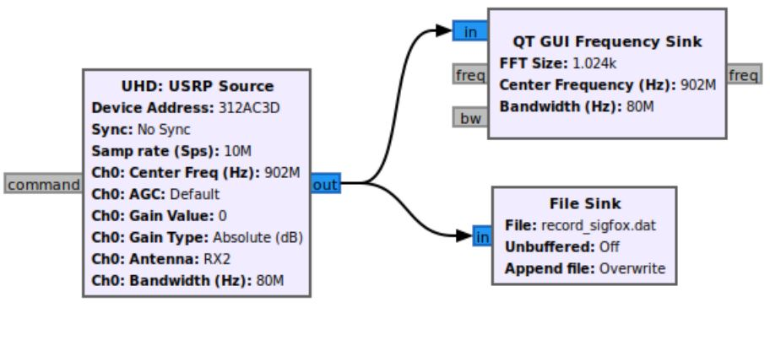
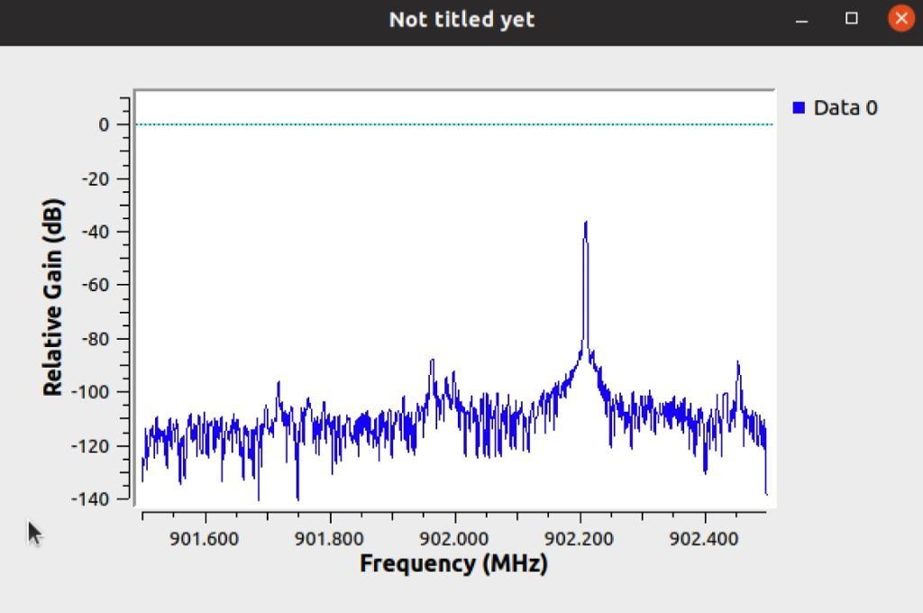
Success! Able to capture and replay Pycomm signal
GNU Radio flow graph for recording the Sigfox signal
Recorded signal
Notes:
USRP flow graph, play the captured signal, elaborate on three peak signal signature

Slide 8
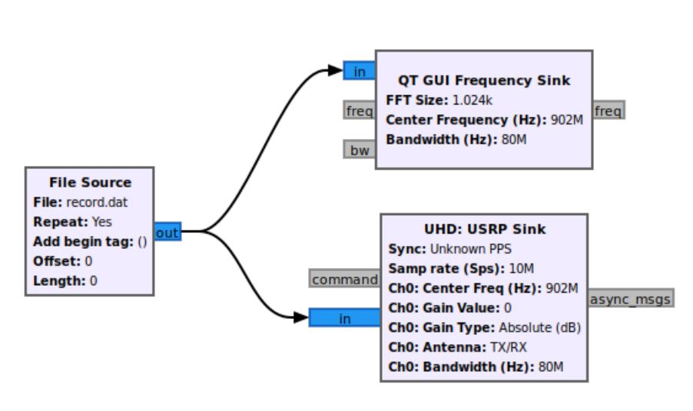
Challenge #3: Replaying the signal does nothing
Raw signal not detected by Sigfox base station
Modified signal headers
Authentication off
No sequence number in packet

Slide 9
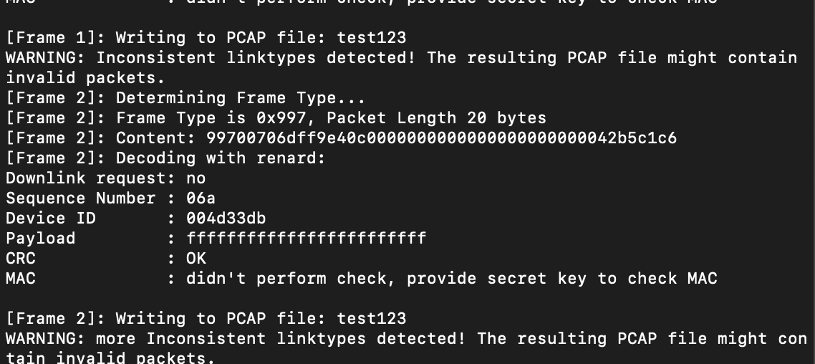
Approach #1: Decode the signal
Used Renard-Phy, an open source reverse sigfox protocol to demodulate signal
The script takes a Sigfox WAV file and normalizes to decode the signal
Tested it with given example (see figure)

Slide 10
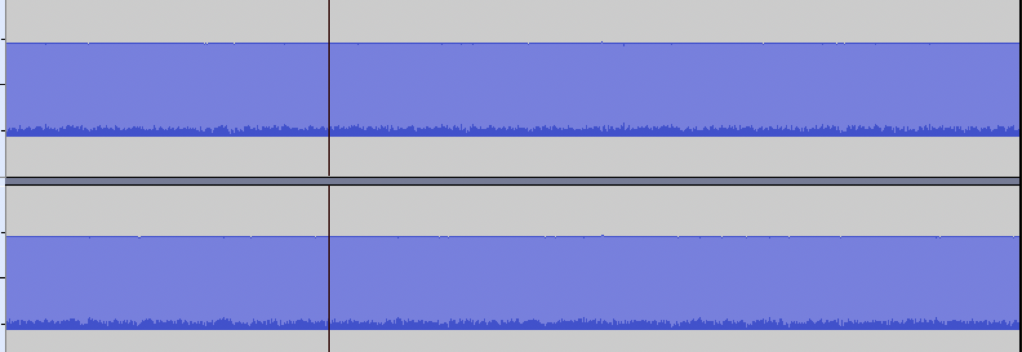
Approach #1: Decode the signal
Tried to convert our recorded DAT file into a WAV file to use the protocol
Failed to convert as we couldn’t figure out the right header for the WAV file
Only static!

Slide 11
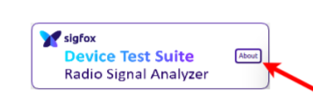
Approach #2: Using Sigfox Radio Signal Analyzer
Used Sigfox RSA to help decode the signal
The RSA showed captured signal when signal sent from the Pycom device
We were able to decode the headers in the RSA
Notes:
TODO: Aarjav

Slide 12
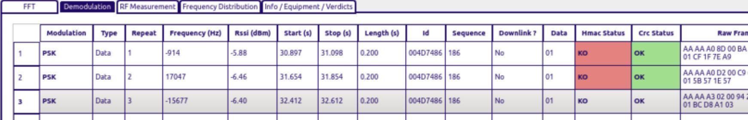
RSA decoder output

Slide 13
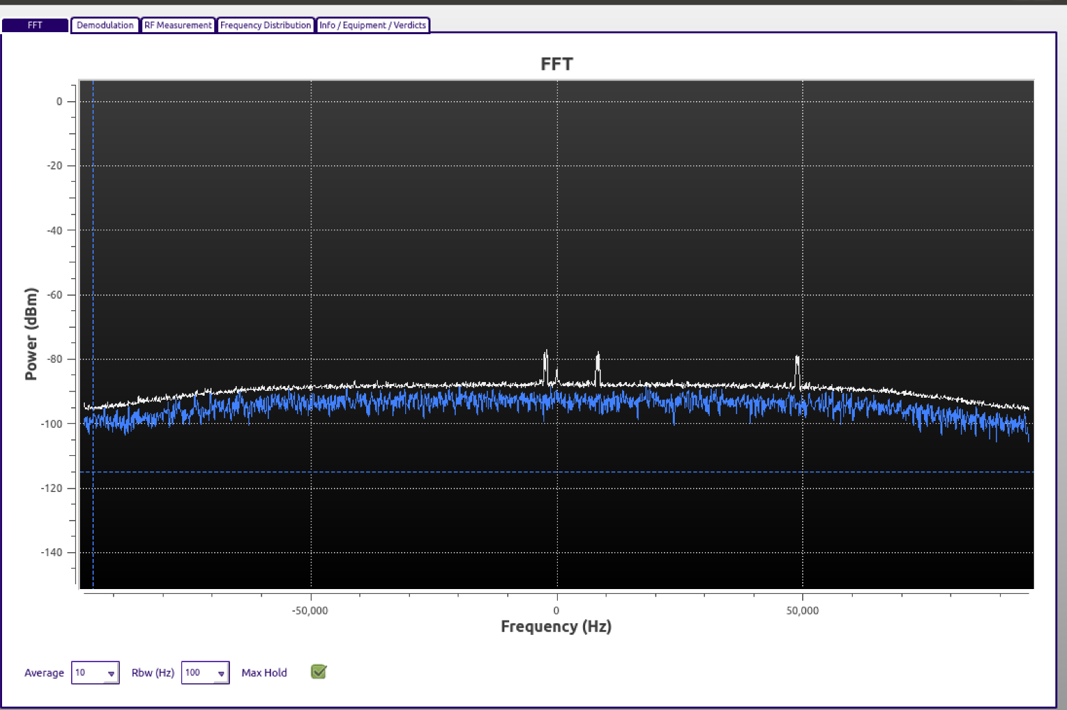
Is USRP really transmitting the signal?
RSA was not able to hear transmitted signals from the USRP with Gain = 0
At Gain = 60, small peaks were observed
Replayed packet was still not decoded

Slide 14
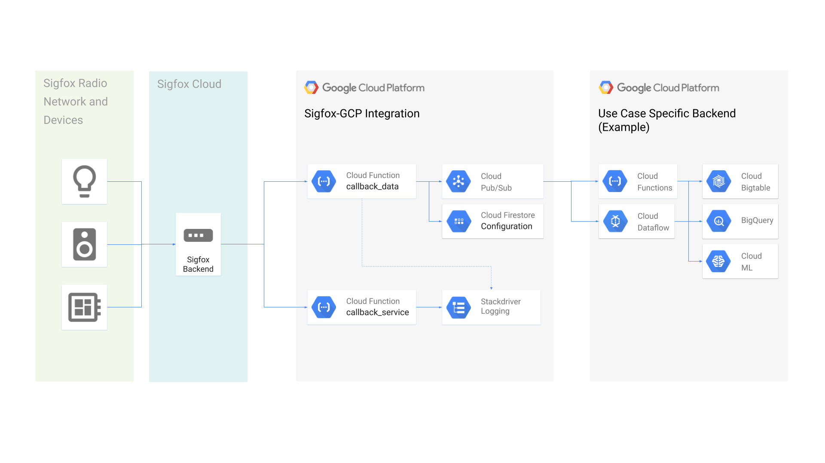
Sigfox in the world

Slide 15
Lessons learned
Deep understanding of networks and communication protocols
How these long range communication protocols are susceptible to attacks
SDRs are a great tool for sniffing communication but also easily accessible by attackers

Slide 16
Questions?

Slide 17
References
Sigfox BS specs - https://support.sigfox.com/docs/sigfox-network-emulator-user-manual
RSA - https://storage.googleapis.com/public-assets-xd-support-sigfox-production-338901379285/47453347-RSA_userguide.pdf
Renard-Phy decoder - https://github.com/Jeija/renard-phy

